Slide 1



Chapter 1
Introduction of Human Resource Management

Slide 2


1. What is human resource management?
Definition of HRM:
Human resource management is to productive use of human resource
make the most to the greatest
benefits of the organization and individuals.
Organization: profits and social commitments. Individuals: development and achievement.

Slide 3

The importance of HRM
People is the key factor of production.
Productivity is the key to measure an organizations’s economic growth potential, and labor quality is the key to improving productivity.
Competition today is the competition for talents.
Since man is the most uncontrollable and unpredictable variable of all production variables, organizational success depends on the management of people.

Slide 4


Functions and divisions of HRM
Management process
Planning.
Organizing.
Staffing.
Leading.
Controlling.

Slide 5

(2) Functions of HRM
Conducting job analysis.
Planning future needs and supplies.
Recruiting and selecting employees.
Orienting and training employees.
Managing wages and benefits.
Performance appraisal.
Communicating (discipline and services).
Building employee commitment (incentives).

Slide 6

(3) Line managers’ HRM responsibilities
Job placing.
Orienting new employees.
On-job training of employees.
Interpreting company policies and
procedures.
Conducting job appraisals.
Controlling labor costs.
Labor protection and disciplines.

Slide 7

(4) Staff managers’ HRM responsibilities
A line function: directing and managing people in the
HRM department.
A coordinating function: coordinating HRM activities
across the organization.
Staff functions:
Same as the HRM functions plus labor relations and collective bargaining with the trade unions.

Slide 8


3. Evolution of HRM
(1) Industrial Revolution:
Adam Smith: specialization and division of labor.
Robert Owens: Pioneer of HRM, performance appraisal
and pay for performance (fair treatment of employees)

Slide 9

(2) Scientific management
Frederic Taylor: Father of scientific management
Definition:
Systematic analysis and breakdown of work into the smallest mechanical components and rearranging them into the most efficient combination.
Steps:
Job analysis—selection—training—rewards.

Slide 10

(4) Human behavior and relations
The Hawthorne Studies by Westing House
The happy workers are the most productive workers.
(The Pet Milk theory)
Max Weber: the Ideal Bureaucracy.
Chris Argyris: Individual and organization—mutual
adjustment.
Affected by the theories of behavioral science and system theory.

Slide 11














Human Resource
Management:
Treating human resource as an asset.
Emphasizing joint
responsibilities of line managers and staff managers.
Government Accountability (1964-1980): Compliance to government regulations.
File Management (1900- 1964):collecting and storing data of each employee.

Slide 12
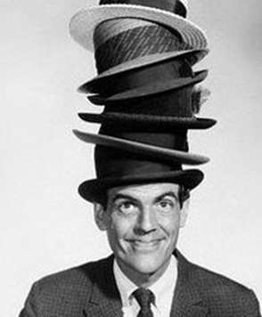
The Multiple Roles of HR Managers
4 key roles for HR managers
Strategic Partner
Administrative Expert
Employee Champion
Change Agent
Notes:
HR Managers have many many roles to play in an organisation, however the 4 KEY roles are
Strategic Partner
Administrative Expert
Employee Champion
Change Agent
Let us run through these roles in a little more detail and discuss.

Slide 13
Strategic Partner
Ability to translate business strategy into action
HRM part of the business team
Know the business: The Bottom-Line
Add value
Measure performance
Provide Professional advise
Make the line managers job easier
Notes:
Where the HR Manager has gained a seat at the management table and adds value through direct impact on quantifiable business objectives.
Every HR decision, plan, or process has to be aligned with the core business strategy.
The HR Manager needs to quickly develop business acumen, must be able to add value to the organization’s overall strategic objectives by employing a shared mind-set and accountability to key performance indicators.
To add value, HR must innovate and continue to step outside of traditional roles and proactively seek out opportunities to learn the business.
To participate and contribute in business discussions, HR business partners must not only ensure smooth systems and processes, but consider the strategic impacts of talent and organization choices.
It is all about creating and delivering value aligned with the organization’s objectives.
HR must first be strategic business partners who just happen to manage the most valuable assets of the organization—its human capital.

Slide 14
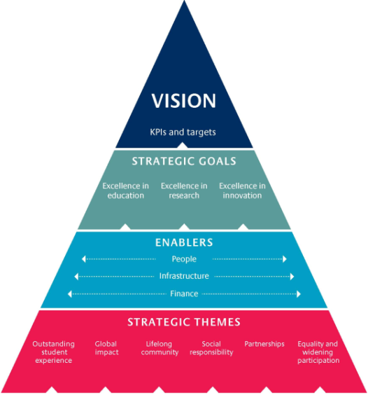
Strategic Partner cont.
“A business with HRM involved at strategic level has a competitive advantage”
Notes:
“A business with HRM involved at strategic level has a competitive advantage”

Slide 15
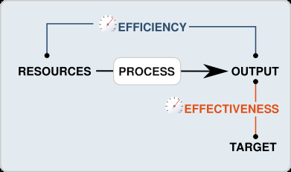
Administrative Expert
Efficiency of HRM (Cost)
Effective management of HR Activities (Quality)
Re-engineer HR processes using technology and innovation
Create value
Measure HR activity results in terms above
Notes:
The difference between efficient and effective is that efficiency refers to how well you do something, whereas effectiveness refers to how useful it is.
For example, if a company is not doing well and they decide to train their workforce on a new technology.
The training goes really well - they train all their employees in record time and tests show they have absorbed the training well.
But overall productivity doesn't improve. In this case the company's strategy was efficient but not effective.

Slide 16

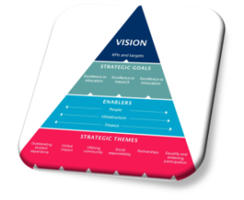

Employee Advocate
Meet the needs of employees
Being fair and principled
Assuring employees their voice is being heard
Assist employees find new resources so that they can perform their jobs better
Notes:
To be an Employee Champion requires the HR Manager to be the employees voice in management decisions
The HR Manager needs to be on “everyone’s” side
An approach to be Fair & Principled is needed
Good employee relationships will help and keep HRM’s finger on the pulse and consider Employee responses to any changes
It is a tricky balance to achieve, but is critical to the organisation’s health

Slide 17

Agent for change & cultural transformation
Change agent –
Catalyst for change
Leading Change (Including in HR)
Problem Solving
Communication
Influencing and convincing skills
Cultural transformation
Culture of excellence
Excellent leadership, planning, processes, people, customer satisfaction, measurement and analysis
Notes:
A change agent is a person who acts as a catalyst for change within the organisation
Start by leading change within the HR Department and Function itself
Develop new Problem Solving Communication & Influence Skills
The HR FUNCTION MUST CHANGE, AND LEAD THE CHANGE
The HR Function must change to be more critical & more strategic
The HR Manager needs to lead the Organisation’s Cultural Transformation and have a transformational effect on the organizations workplace culture

